Slide 1
Micro Credit Project

Slide 2
Problem Statement
In the developing countries, the percentage of population who are below poverty line is more and are uneducated to earn their living.
And these are situation which lead to drop of economy in the country. If we can address this problem in the country and give these people a means of earnings, it would address this problem.
These financial schemes are offered chiefly for micro enterprise activities such as agricultural activities, artisan activities, etc.
These schemes assist low-income individuals to engage themselves in income-generating activities for a sustainable livelihood. Micro credit schemes are provided to self-help groups as well in order to enable them to set up ventures and earn incomes. These schemes are helpful to tribal people as well.

Slide 3
Exploratory Data Analysis
I would mainly divide this data study into 2 parts
Understand what is in the Data set, which is important to make a valid conclusion for the client?
Understand who are the bank micro loan customers ? How are the features related to each other?

Slide 4
Understand the Numeric data
Describe function in python , help me to identify there from the data
Unnamed-drop-Unnamed
Label-imbalance
msisdn- drop, mobile Number-change to int
aon-Number of days on Nework-Average age being 22-The max value is equal to 2739 years on cellular networks, Which is impossible-Check on annomylies in this column and Min being -49 days age?
daily_decr30, daily_decr90,rental30 , rental90- The amount spent on max looks far beyond the average and negative amount spending on recharge is not possible
last_rech_date_ma, last_rech_date_da- The Number of days for any rechange cannot be max in so high as max value, corresponding to 2736 years
r_ma_rech30 sumamnt_ma_rech30 medianamnt_ma_rech30 medianmarechprebal30, -The amount to rechange canot be 0
Same as in for 90 dayds
pdate-need a change in datatyp
maxamnt_loans30 - max value looks anomy as median for the same dat ais not in same bracket

Slide 5
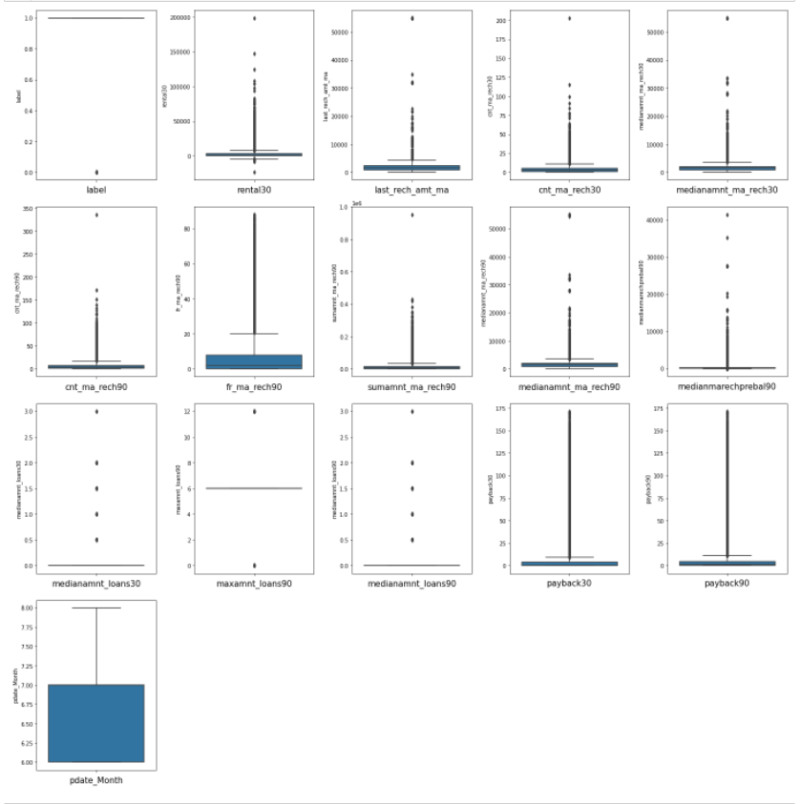
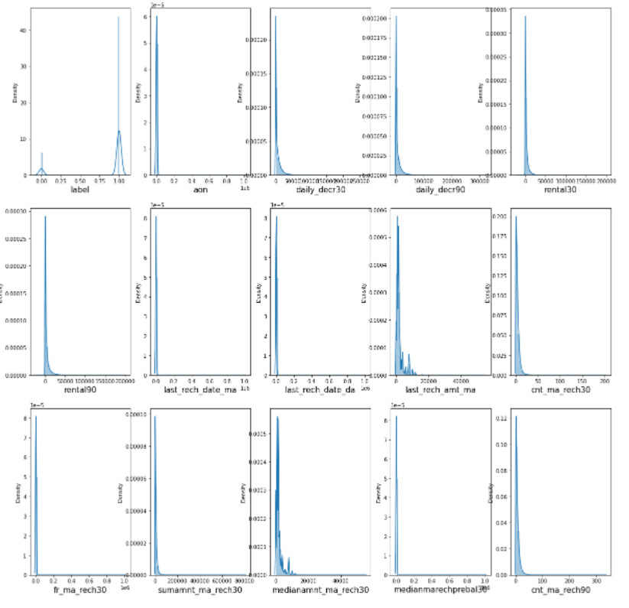
Understand the distribution of the data

Slide 6
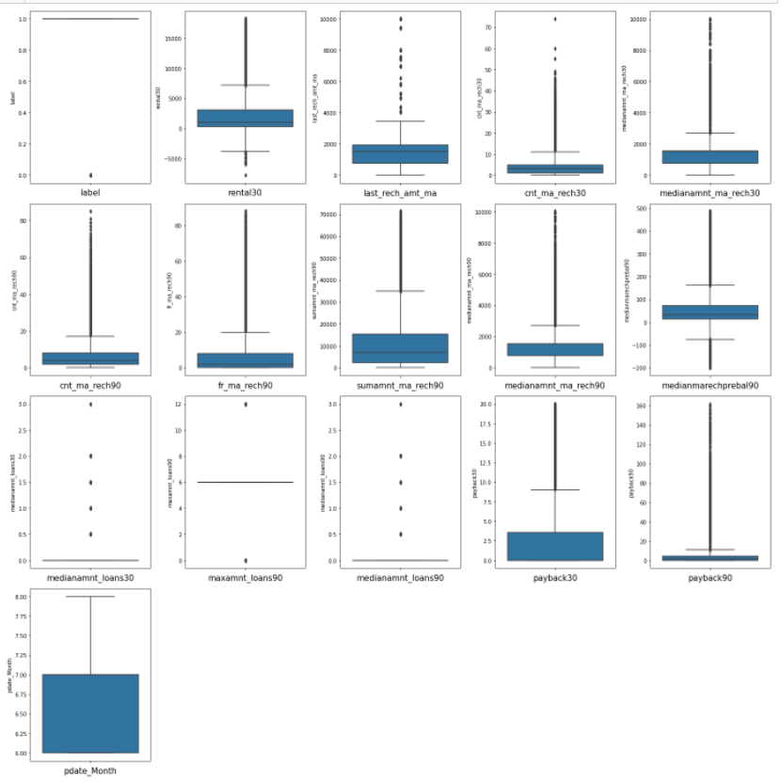
Rectify the screwness

Slide 7
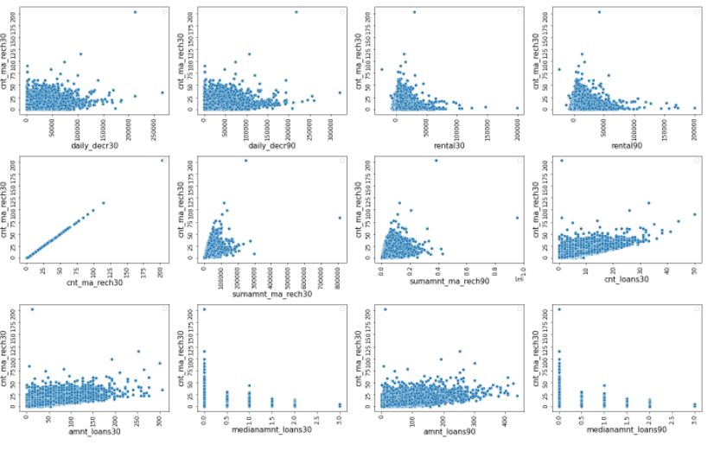
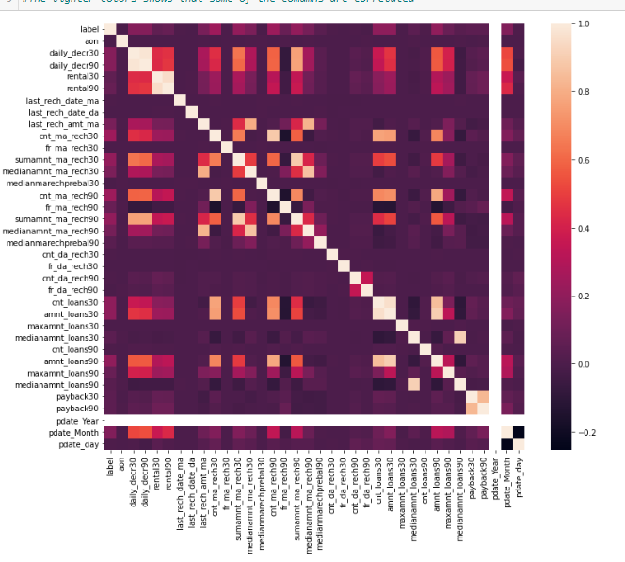
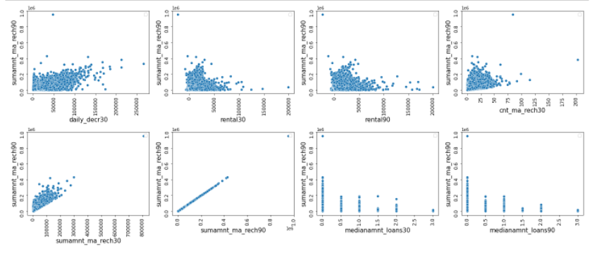
Checked for Multicollinearity

Slide 8

Data set made balanced with Oversampling SMOTE

Slide 9
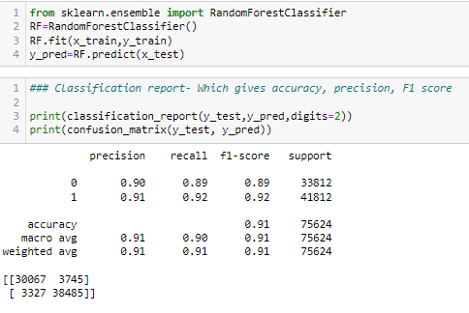
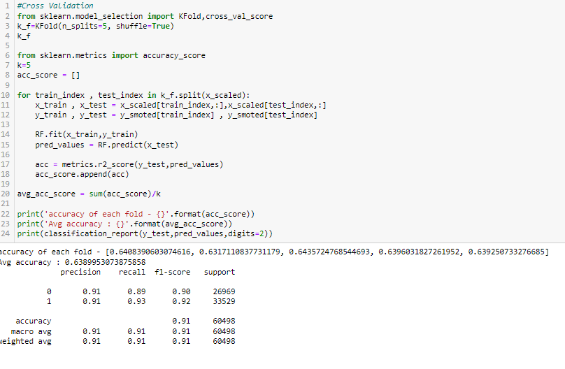
Model selected and checked for Overfitting/underfitting problems in the model
Metrics for Model
Model

Slide 10
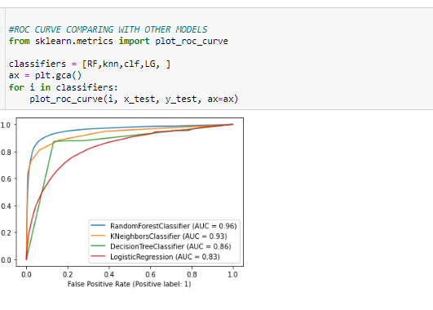
Checked that it’s the best model among multiple models

Slide 11
THANK YOU

